Slide 1
Course Code: CSC211A Course Title: Formal Languages and Automata Theory
Lecture 22:NDPA-2
Course Leader:
Prakash P
prakashp.cs.et@msruas.ac.in

Slide 2
Session Objectives
At the end of this session, student will be able
Explain the grammar construction
Describe derivation of string
Explain the conversion of context free grammar to NPDA

Slide 3
Session Topics
Grammar construction
Derivation of string
Conversion of context free grammar to NPDA

Slide 4
Converting Context-Free Grammars to NPDAs

Slide 5
An Example Grammar
What is the equivalent NPDA?

Slide 6
An Example Grammar
Grammar:
NPDA:

Slide 7
An Example Grammar
The NPDA simulates leftmost derivations of the grammar
L(Grammar) = L(NPDA)

Slide 8
An Example Grammar
Grammar:
A leftmost derivation:

Slide 9
NPDA Execution
Input
Time 0
Stack
current
state

Slide 10
Time 1
Input
Stack

Slide 11
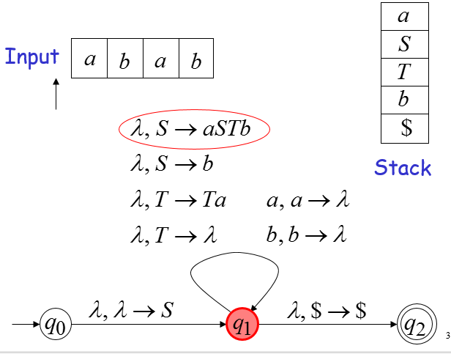
Time 2

Slide 12
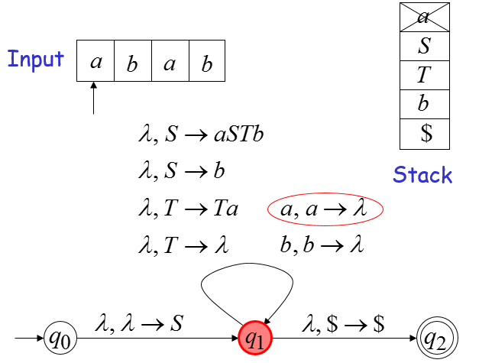
Time 3

Slide 13
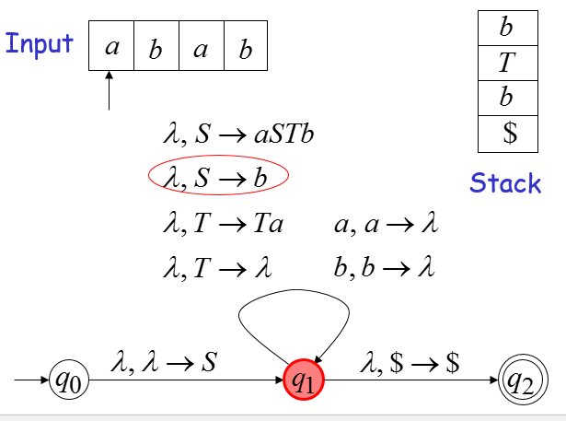
Time 4

Slide 14
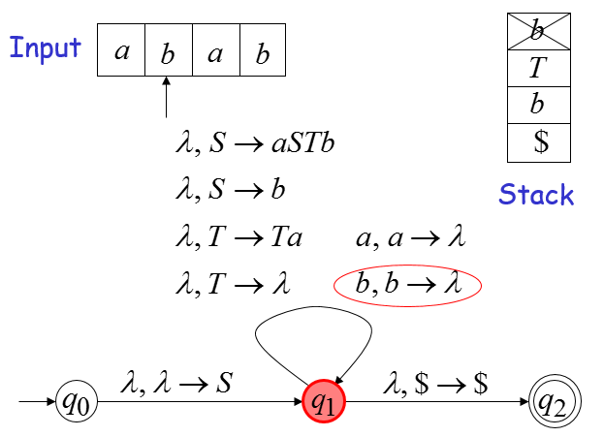
Time 5

Slide 15
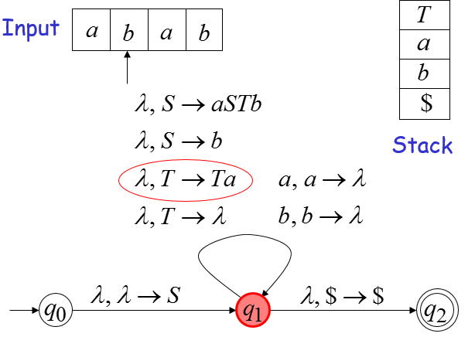
Time 6

Slide 16
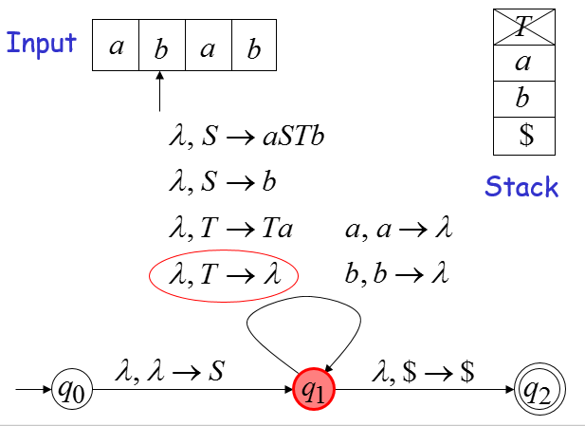
Time 7

Slide 17
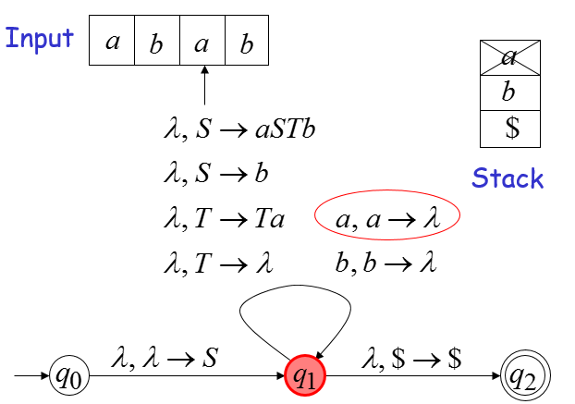
Time 8

Slide 18
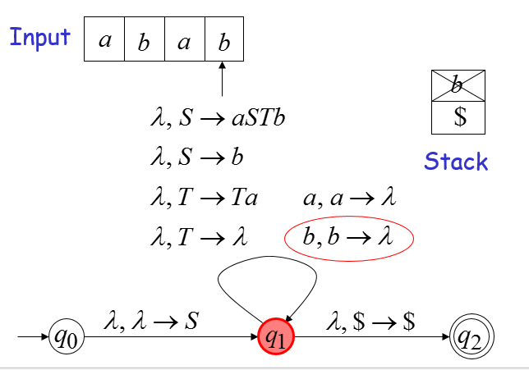
Time 9

Slide 19
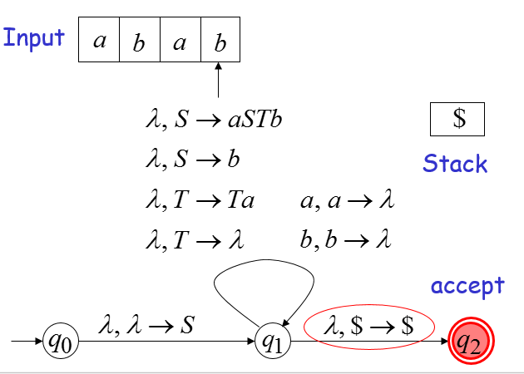
Time 10

Slide 20
In General
Given any grammar
We can construct a NPDA
With

Slide 21
In General
Constructing NPDA from grammar :
For any production
For any terminal

Slide 22
Proof
Grammar generates string
if and only if
NPDA accepts

Slide 23
Proof
Therefore:
For any context-free language there is an NPDA that accepts the same language

Slide 24
Converting NPDAs to Context-Free Grammars

Slide 25
Proof
For any NPDA
we will construct a context-free grammar with

Slide 26
Proof
Intuition:
The grammar simulates the machine
A derivation in Grammar :
Current configuration in NPDA

Slide 27
Proof
A derivation in Grammar :
terminals
variables
Input processed
Stack contents
in NPDA

Slide 28
Some Necessary Modifications
First, we modify the NPDA:
It has a single final state
It empties the stack when it accepts the input
Original NPDA
Empty Stack

Slide 29
Some Necessary Modifications
Second, we modify the NPDA transitions:
all transitions will have form
or

Slide 30
Example of a NPDA

Slide 31
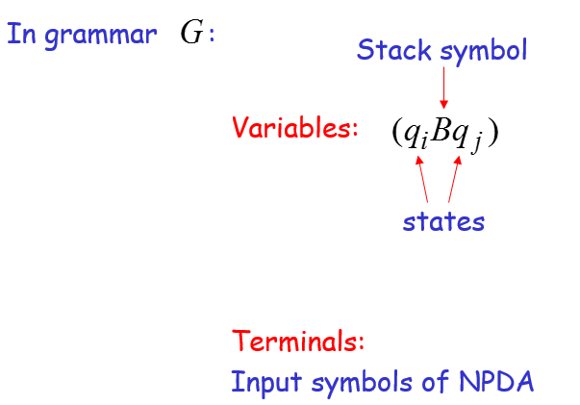
The Grammar Construction

Slide 32
The Grammar Construction
For each transition
We add production

Slide 33
The Grammar Construction
For each transition
We add production
For all states

Slide 34
The Grammar Construction
Stack bottom symbol
Start Variable:
Start state
final state

Slide 35
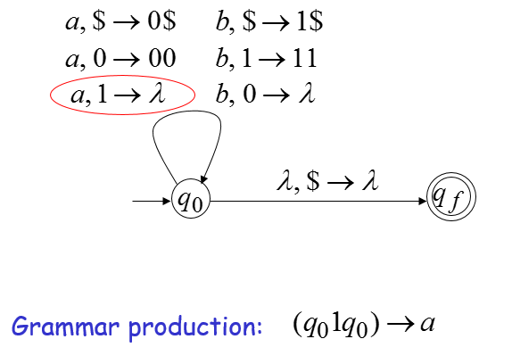
Example

Slide 36
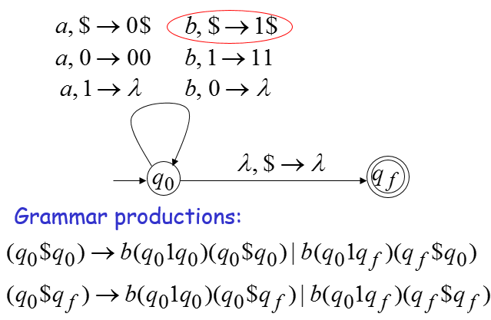
Example

Slide 37
Example
Grammar production:

Slide 38
Resulting Grammar

Slide 39
Resulting Grammar

Slide 40
Derivation of String

Slide 41
Derivation of String
In general, in Grammar:
if and only if
is accepted by the NPDA

Slide 42
Explanation
By construction of Grammar:
if and only if
in the NPDA going from to the stack doesn’t change below and is removed from stack

Slide 43
Summary
In this lecture conversion of context-free grammars to NPDAs is discussed
For any context-free language there is an NPDA that accepts the same language

